Slide 1
NLP Project
COVID-19 Twitter Data Sentiment Analysis
Presentation By:
Apurv Jain (2017KUCP1016)
Submitted To:
Dr. Basant Agarwal
Dept. of CSE
IIIT Kota

Slide 2
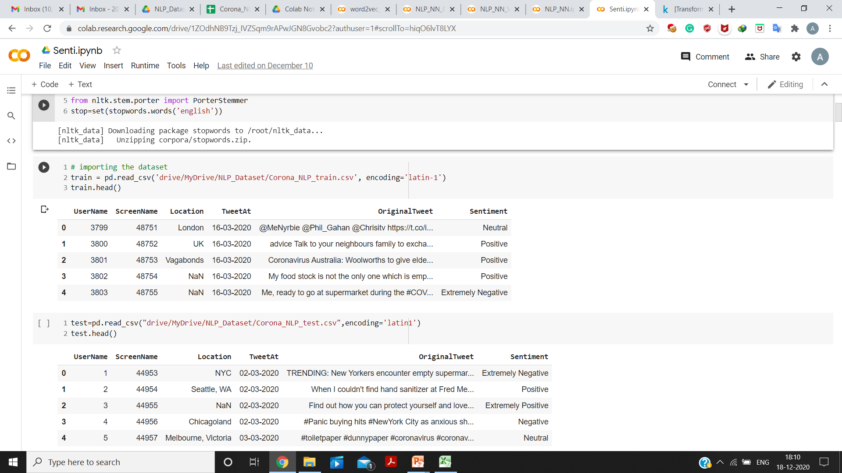
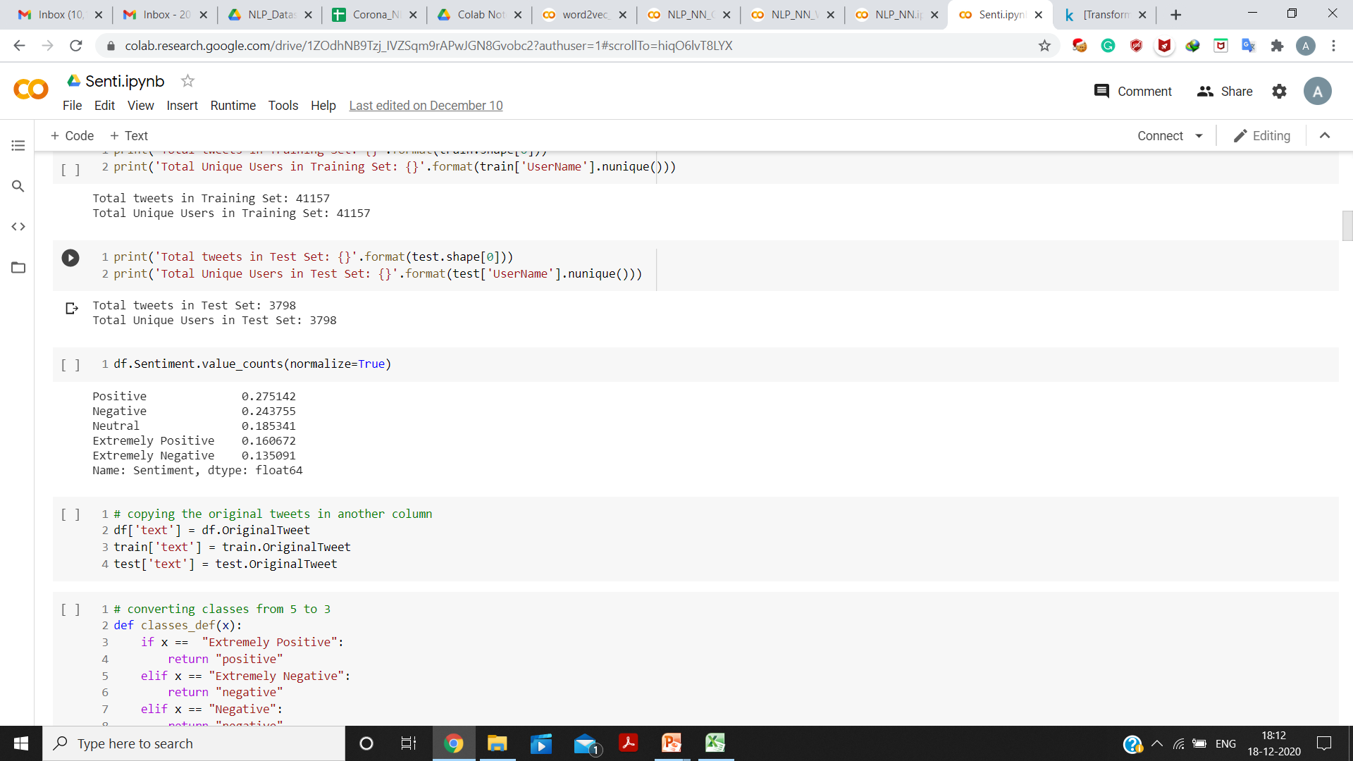
Data Analysis
Dataset consists of 6 columns:
UserName
ScreenName
Location
TweetAt
OriginalTweet
Sentiment
Total Tweets in Training Set: 41157
Total Tweets in Test Set: 3798
Sentiment class consists of five classes: Extremely Positive, Positive, Neutral, Negative and Extremely Negative.

Slide 3
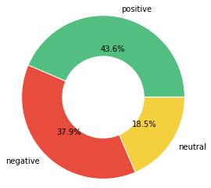
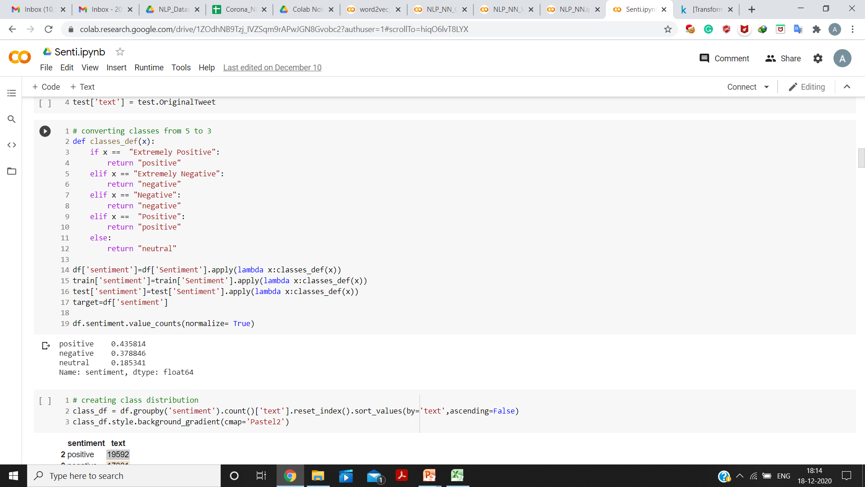
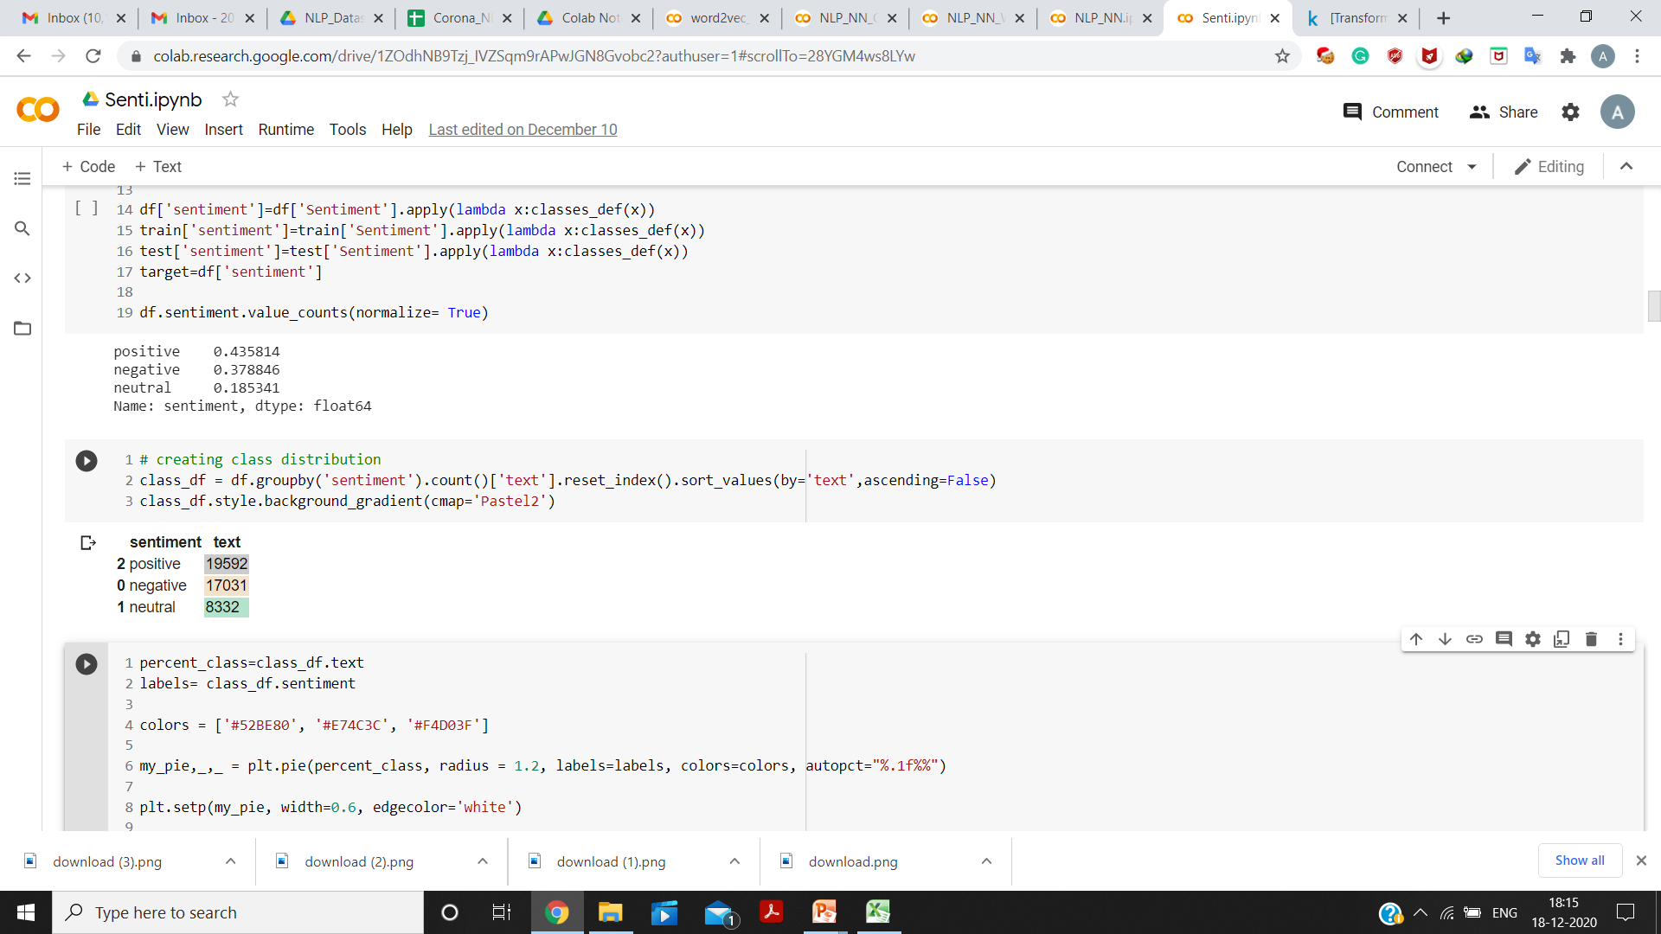
Data Analysis
For ease of doing the task, the number of classes was reduced to three: Positive, Neutral and Negative.

Slide 4
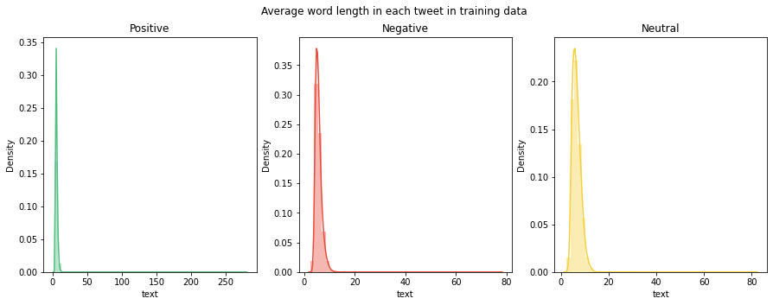
Average word length in each tweet in training data

Slide 5
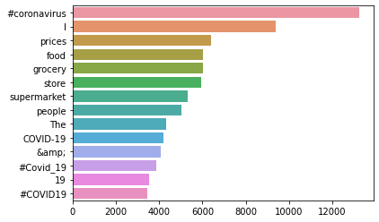
Words with maximum Word Count

Slide 6
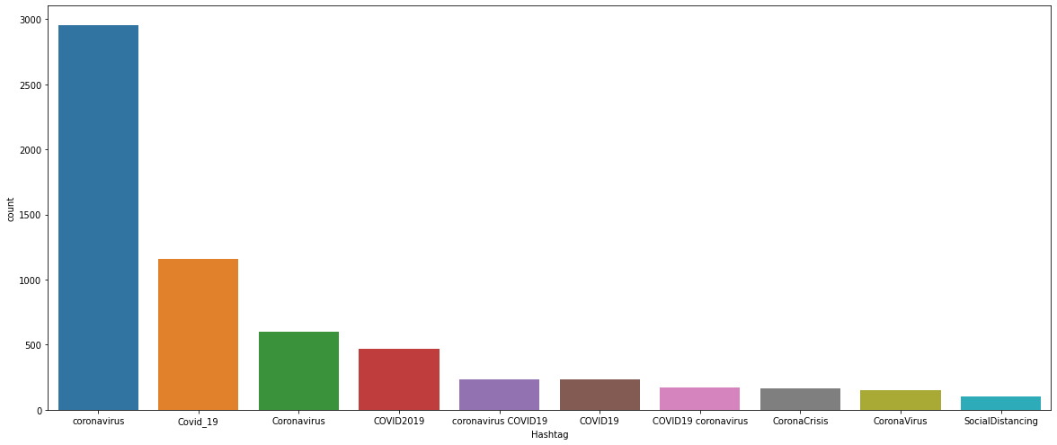
Top 10 Hashtags

Slide 7
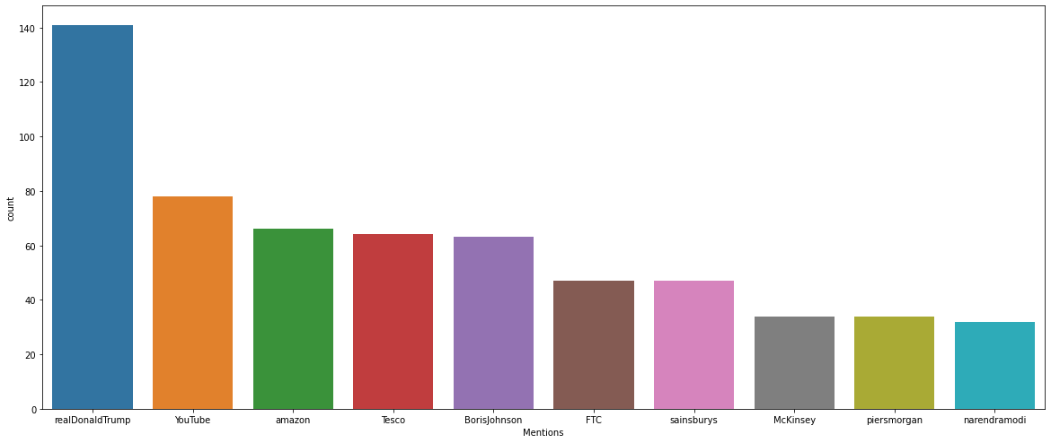
Top 10 Mentions

Slide 8
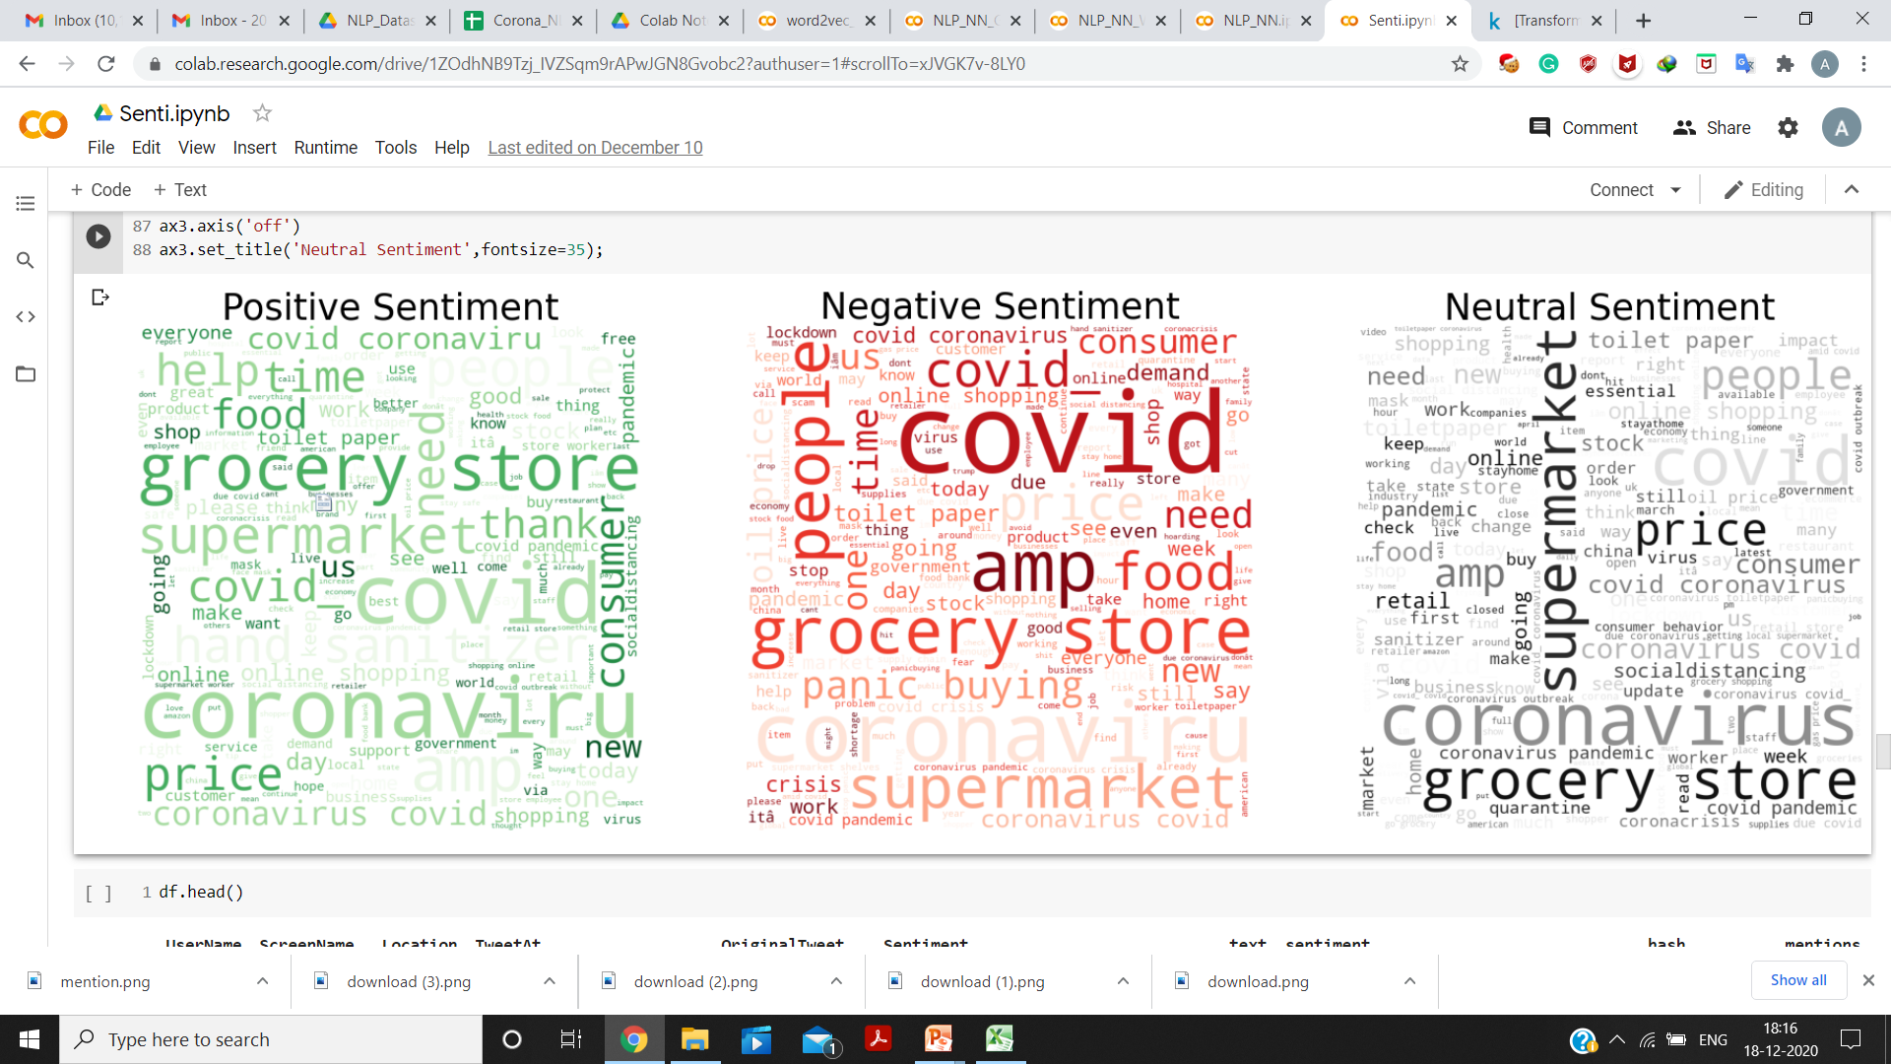
Word Cloud for each class

Slide 9
Data Pre-processing steps
Removing of URLs and HTML Links from Tweets
Lower-casing of text
Removing of numbers
Removing of common English Stop words and Punctuations
Removing of extra whitespace left
Conversion of classes from string to numbers:
0 for ‘Neutral’
1 for ‘Negative’
2 for ‘Positive’

Slide 10
Models used
Random Forests, Linear SVM, Multinomial Naïve Bayes using TF-IDF.
A simple CNN Network
CNN using GloVe Embedding (for Twitter Data)
CNN using Word2Vec Embedding (generated using Gensim)

Slide 11
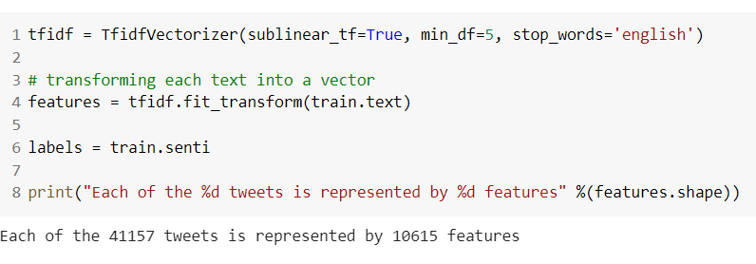

TF-IDF
sublinear_tf = True, to replace ‘tf’ with ‘1+$\log\left(\text{tf}\right)$’.
min_df = 5, to ignore terms with document-frequency less than 5.

Slide 12
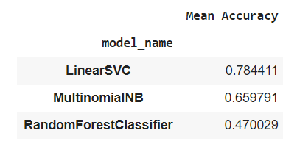
Comparison b/w RF, Linear SVM and Multinomial NB
Used 5-fold Cross Validation for comparison.
Linear SVM performed the best with 78% Accuracy.
Notes:
LinearSVC uses One v/s Rest approach for Multi-class Classification.

Slide 13
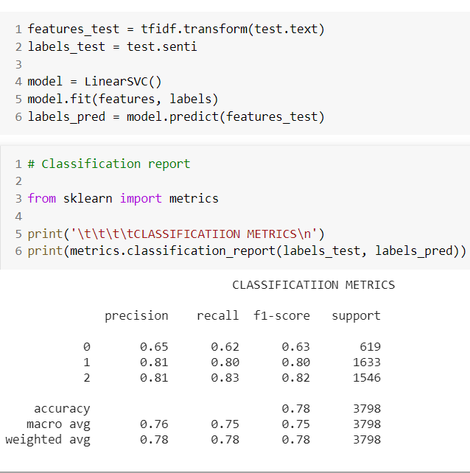
Using Linear SVM for Testing

Slide 14
CNN based Models

Slide 15
Some more Data Pre-processing
One-hot encoded the labels (classes)
Pad-sequences, maxlen = 41 (the maximum length of a sentence in the dataset)
Used Tokenizer available in Keras. Vocab Size=59192

Slide 16
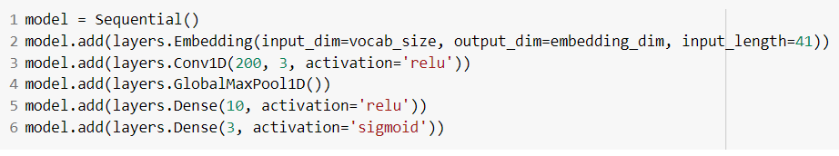
A simple CNN Model
Embedding size: 50
Filter size: 200
Kernel size: 3

Slide 17
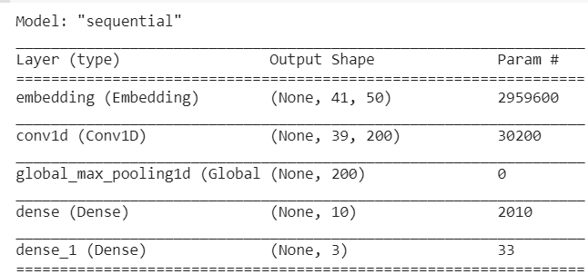

Slide 18
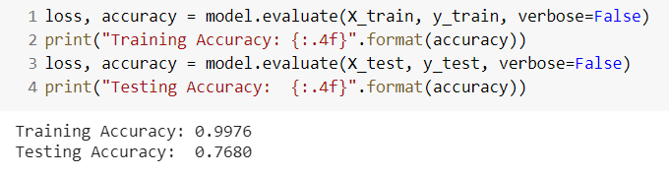
Output

Slide 19
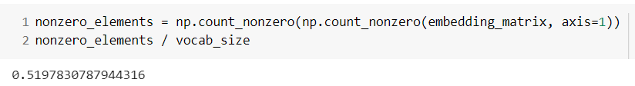
CNN Model using GloVe Embedding
Embedding dim: 50
Embedding Matrix generated using GloVe Twitter data
Embedding generated for about 52% of vocabulary.

Slide 20
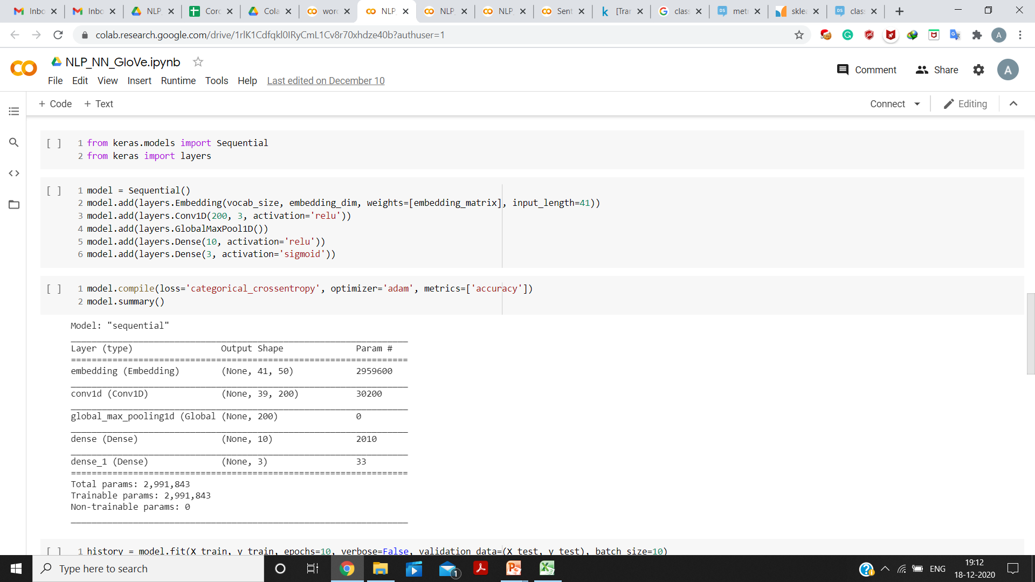
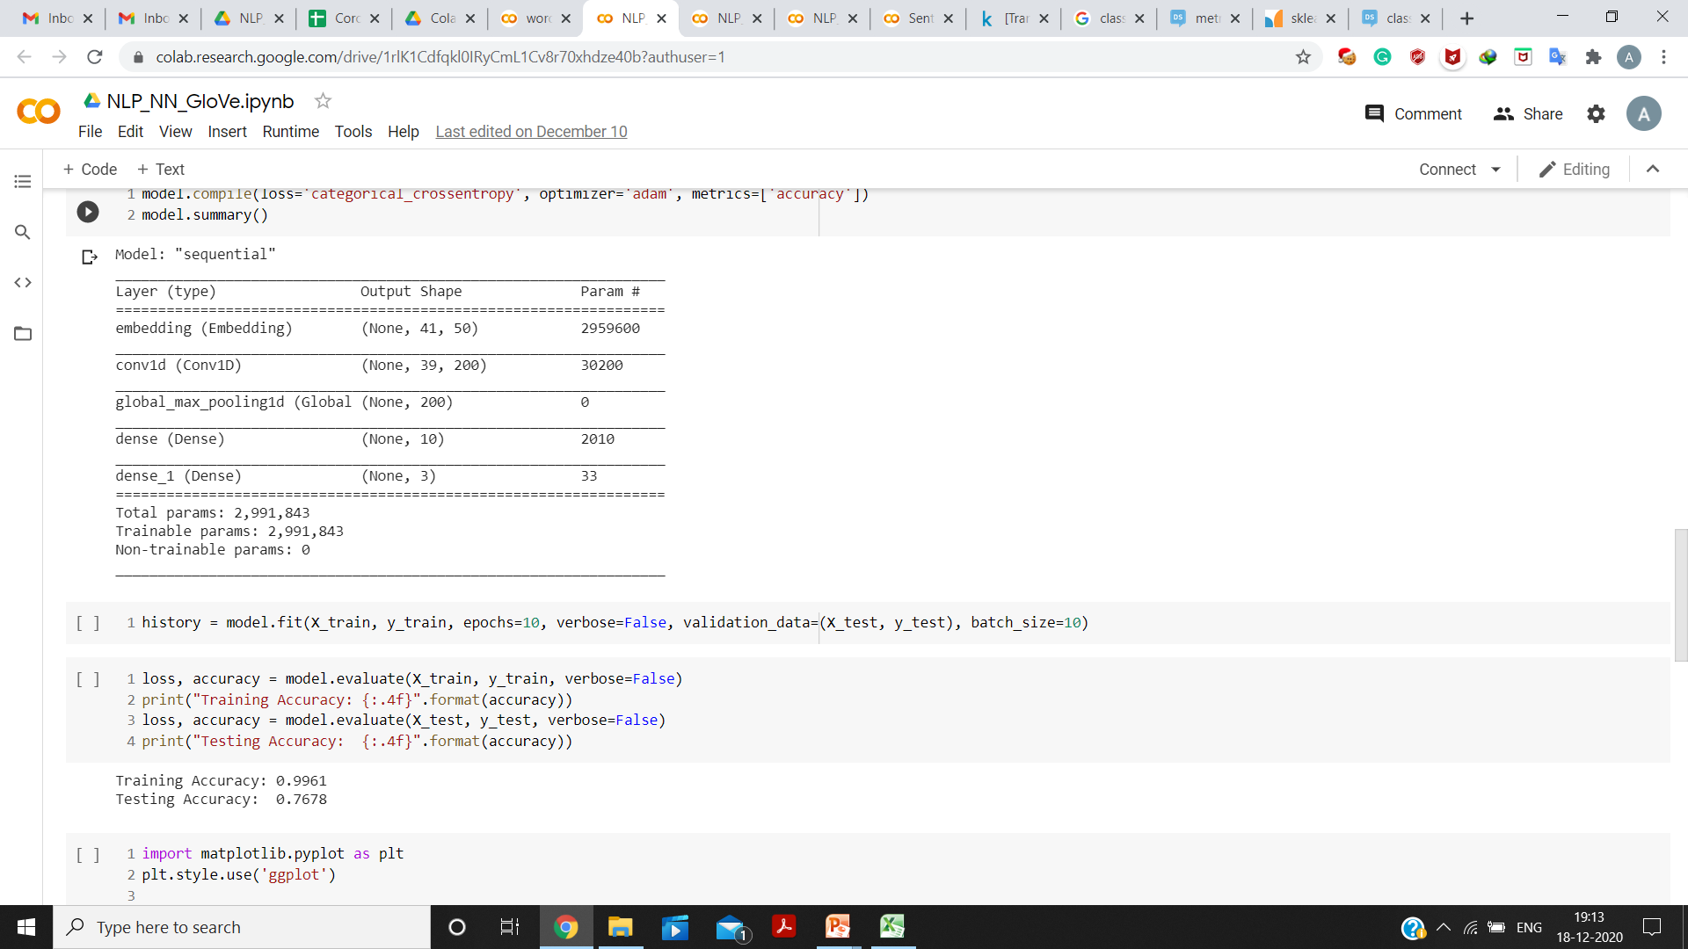

Slide 21
Output

Slide 22
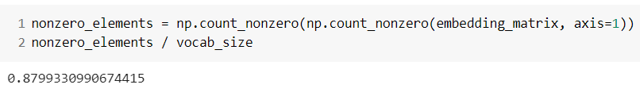
CNN model using Word2Vec Embedding
Generated Embedding using Gensim
CBOW and Skip-gram. Embedding dim for each: 50
Embedding generated for about 88% of vocabulary.

Slide 23
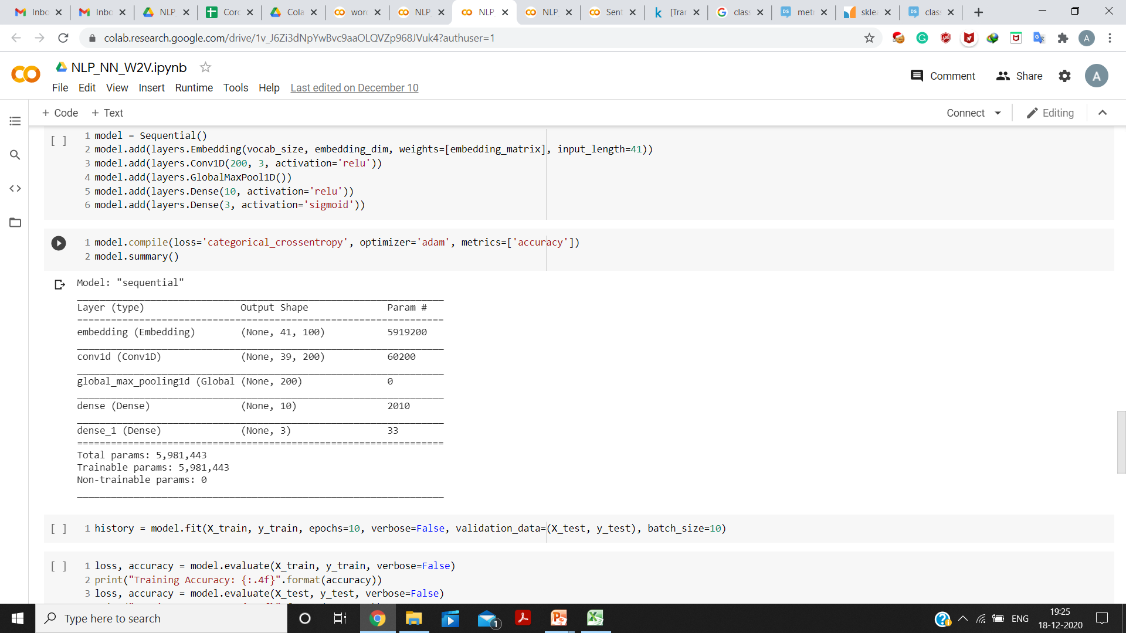
Embedding dim (in this case): 50 + 50 = 100

Slide 24
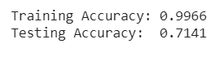
Output

Slide 25
Comparison
Model | Tokenizer used | Testing Accuracy
Linear SVM | TF-IDF | 78%
Simple CNN | Keras Tokenizer | 76.8%
CNN (GloVe) | Keras Tokenizer | 76.78%
CNN (Word2Vec) | Keras Tokenizer | 71.41%

Slide 26


